Slide 1

Notes:
Welcome everyone. Today, we are walking through the journey and mechanics of building independence as a private micro-cap stock picker, drawing directly from Ian Cassel’s experience and frameworks detailed in his book Stock Picker.
We will cover two major domains: the psychological survival mechanics required to endure full-time private investing, and the practical portfolio mechanics necessary when navigating the fragile world of micro-cap stocks.
This evolution spans over two decades—starting from early luck and isolation, transitioning into structured execution, and ultimately achieving full autonomy.
https://www.youtube.com/watch?v=TFMyFup1k48

Slide 2

Notes:
Many investors dream of transitioning to full-time private investing as the absolute pinnacle of financial freedom. On paper, the appeal is total autonomy: no bosses, no clients, no LP demands, and no corporate bureaucracy.
However, as Ian Cassel emphasizes, absolute autonomy comes with absolute vulnerability. There is no safety net—no 401(k) match, no employer-sponsored healthcare, and no regular paycheck coming in every two weeks.
You exist in a literal "what you eat is what you kill" reality. The mental and emotional burden of managing personal expenses entirely through portfolio gains—especially through brutal drawdown years—is severe.

Slide 3
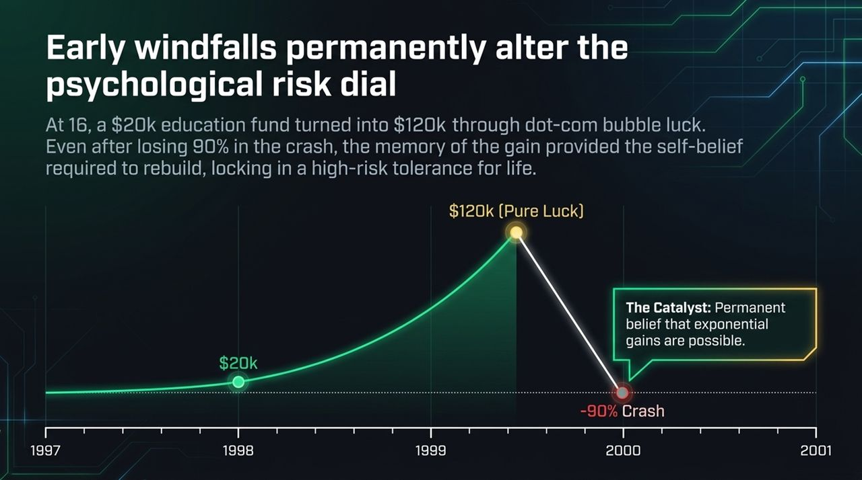
Notes:
Early experiences permanently set an investor's psychological risk dial. At age 16, Ian turned a $20,000 college fund into $120,000 during the dot-com bubble.
While that gain was driven by market luck rather than skill, the psychological impact was permanent. Even after losing 90% of those gains when the bubble burst, the memory of that initial windfall created an unshakable self-belief that exponential returns were possible.
That early taste of success anchored a higher risk tolerance for life, providing the confidence required to dust off the losses, rebuild, and pursue full-time stock picking.

Slide 4
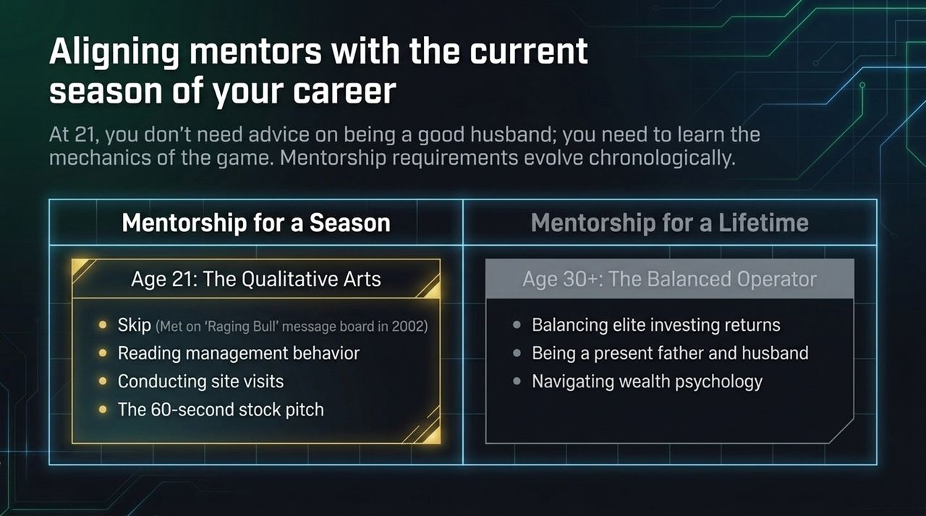
Notes:
A common mistake among young professionals is looking for a "one-size-fits-all" mentor. Mentorship requirements naturally evolve across different seasons of life.
At age 21, Ian was mentored by "Skip," an old-school Wall Street broker met on the Raging Bull message boards. Skip didn't offer advice on personal life or marriage, but he taught the raw qualitative arts: reading management body language, conducting site visits, and delivering a tight 60-second stock pitch.
Later in his 30s, as Ian's family grew, his mentorship needs shifted toward the "Balanced Operator"—learning how to generate high returns without sacrificing family life or burning out. Seek mentors tailored to the current stage of your journey.

Slide 5
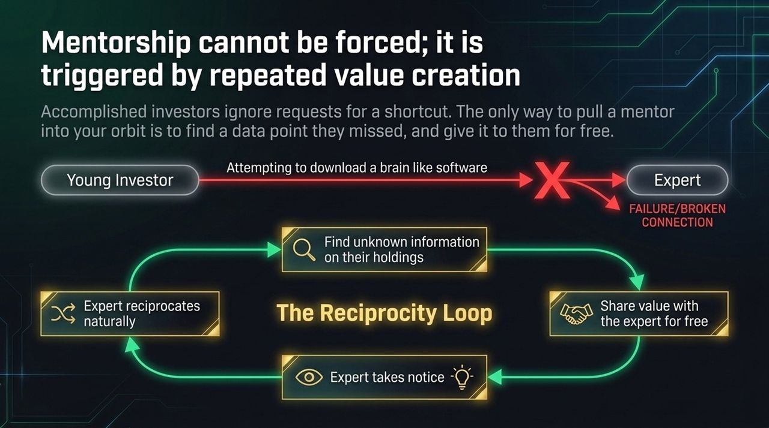
Notes:
High-performing experts and investors ignore generic cold emails asking to "pick their brain" or seeking shortcuts. They see cold approaches as attempts to download their hard-earned knowledge like software.
The only effective way to pull a valuable mentor into your orbit is through the Reciprocity Loop: find valuable, non-obvious data points on companies they already own and give that research to them for free.
By consistently offering value without expecting an immediate return, you naturally compel the expert to notice, engage, and reciprocate.

Slide 6
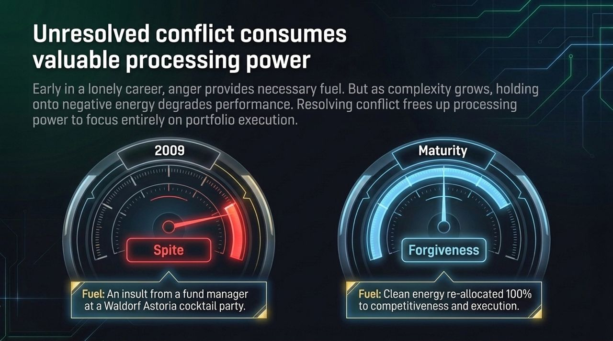
Notes:
In the early stages of a career, spite and anger can serve as potent fuel. Ian recalls an instance in 2009 at a Waldorf Astoria cocktail party where a fund manager insulted him, questioning his ability to hold a real job. For years, proving that manager wrong was a primary driving force.
However, as portfolio complexity increases, holding onto grudges becomes an emotional drag. Carrying negative energy consumes critical cognitive processing power.
Releasing past grievances frees up mental bandwidth. Just like cutting a losing stock frees up capital for better opportunities, resolving interpersonal conflict reallocates 100% of your mental focus toward market execution.

Slide 7
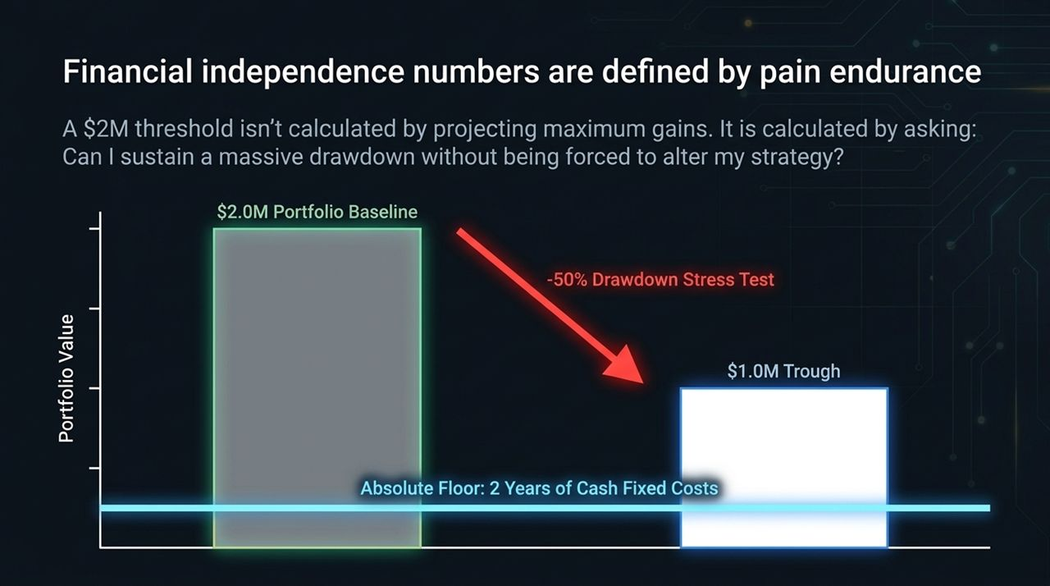
Notes:
Setting a baseline target for full-time private investing—such as $2 million—isn't about projecting best-case returns in a bull market. It is calculated by stress-testing drawdowns.
Ask yourself: Can I endure a 50% drawdown without panicking, abandoning my strategy, or liquidating winning positions at market bottoms to pay living expenses?
To survive, a private investor must maintain an absolute floor—typically 2 years of fixed living costs held in cash—completely independent of portfolio fluctuations.

Slide 8
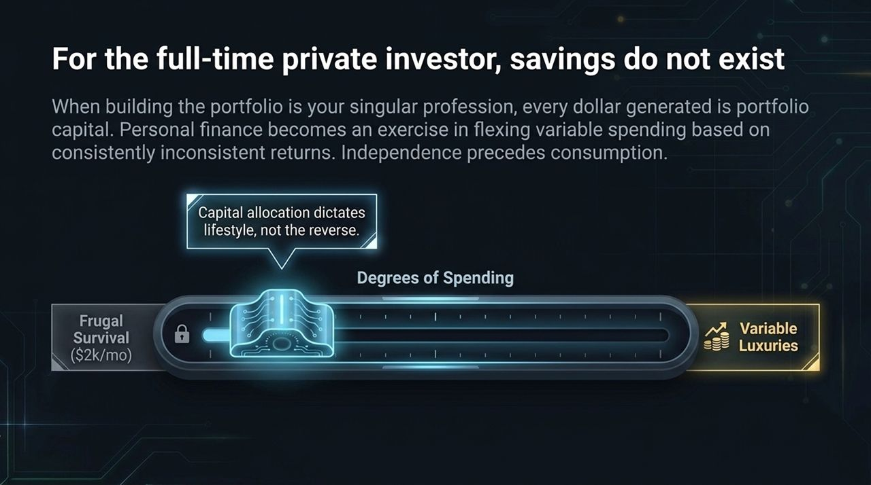
Notes:
For full-time private investors, standard concepts like traditional "savings" disappear. Because the portfolio is your primary enterprise, every dollar retained is active allocation capital.
Managing personal finances becomes an exercise in dynamically scaling variable spending relative to inherently volatile annual returns.
Keep fixed living expenses exceptionally low (a baseline frugal survival mode). Luxuries are funded strictly on variable income after outperformance, ensuring that desire for consumption never compromises investment independence.

Slide 9
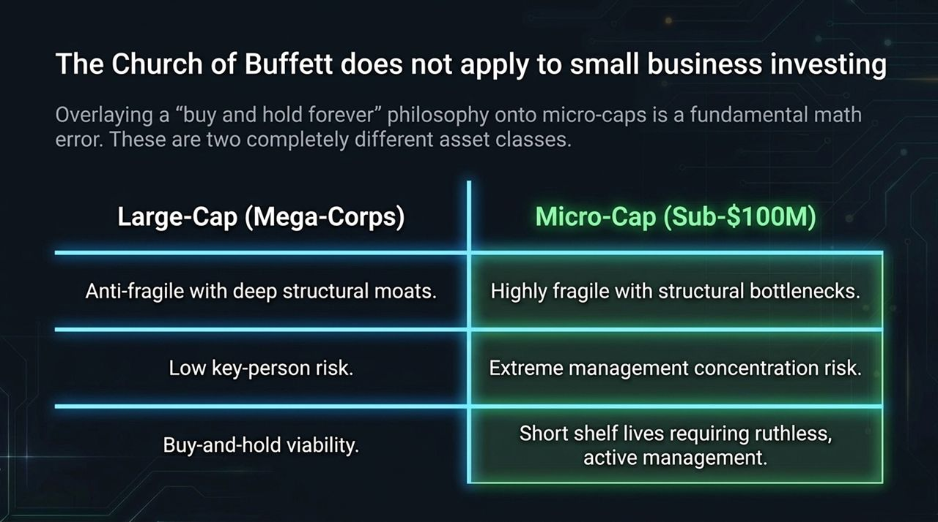
Notes:
Applying Warren Buffett's "buy and hold forever" philosophy directly to sub-$100M micro-caps is a fundamental strategic error. They represent entirely different asset classes.
Mega-cap companies possess structural moats, diversified revenue, and deep management layers. Micro-caps, by contrast, are small businesses with high fragility, severe key-person reliance, and customer concentration risks.
Micro-caps have shorter operational shelf lives and require active, vigilant management rather than passive buy-and-hold strategies.

Slide 10
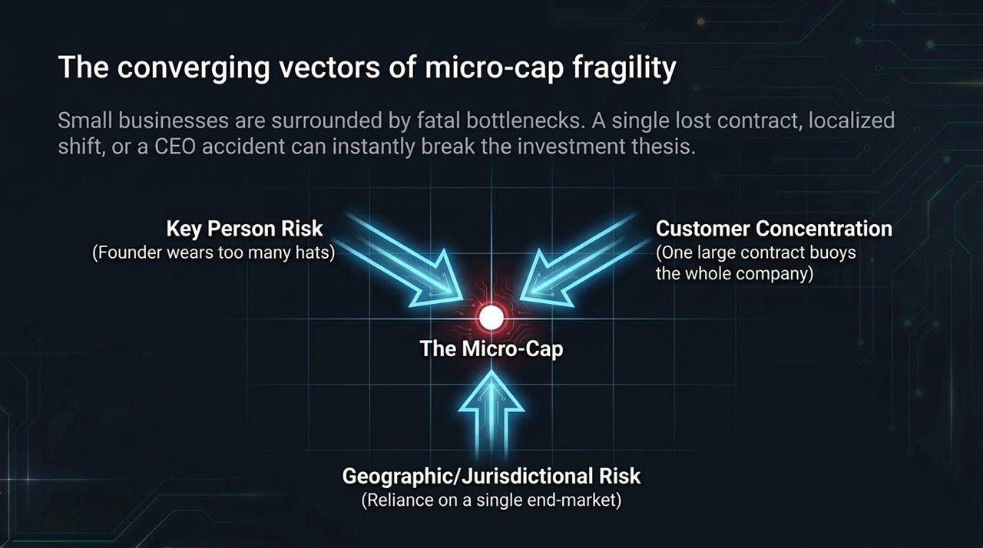
Notes:
Investors must recognize the primary operational bottlenecks surrounding micro-cap businesses:
Key Person Risk: Founders who perform multiple operational roles, creating massive execution exposure.
Customer Concentration: Reliance on 1 or 2 core client contracts to sustain the business.
Jurisdictional/Geographic Constraints: Vulnerability to localized economic shifts or single end-markets.
A single point of failure in any of these areas can immediately break an investment thesis.

Slide 11
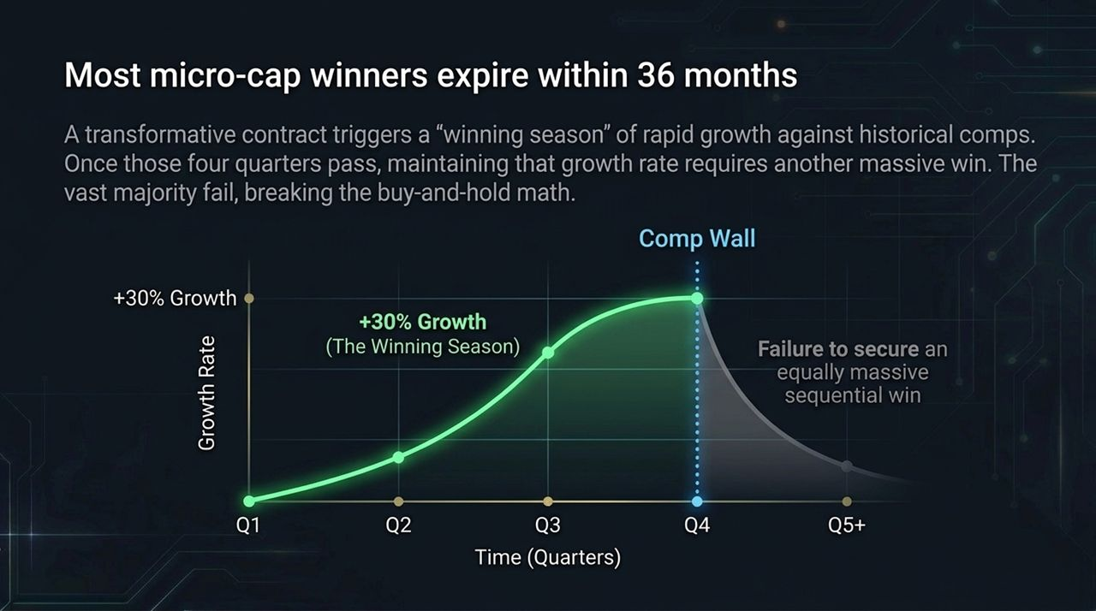
Notes:
When a micro-cap company lands a major customer contract, it often triggers a 12-to-36-month "winning season" characterized by impressive quarter-over-quarter growth against prior metrics.
However, once those four quarters pass, the business hits a "comp wall". Maintaining that growth trajectory requires securing another major contract—something most small businesses fail to achieve sequentially.
As a result, even successful micro-cap positions must typically be exited within a 6-to-36-month window once growth moderates.

Slide 12
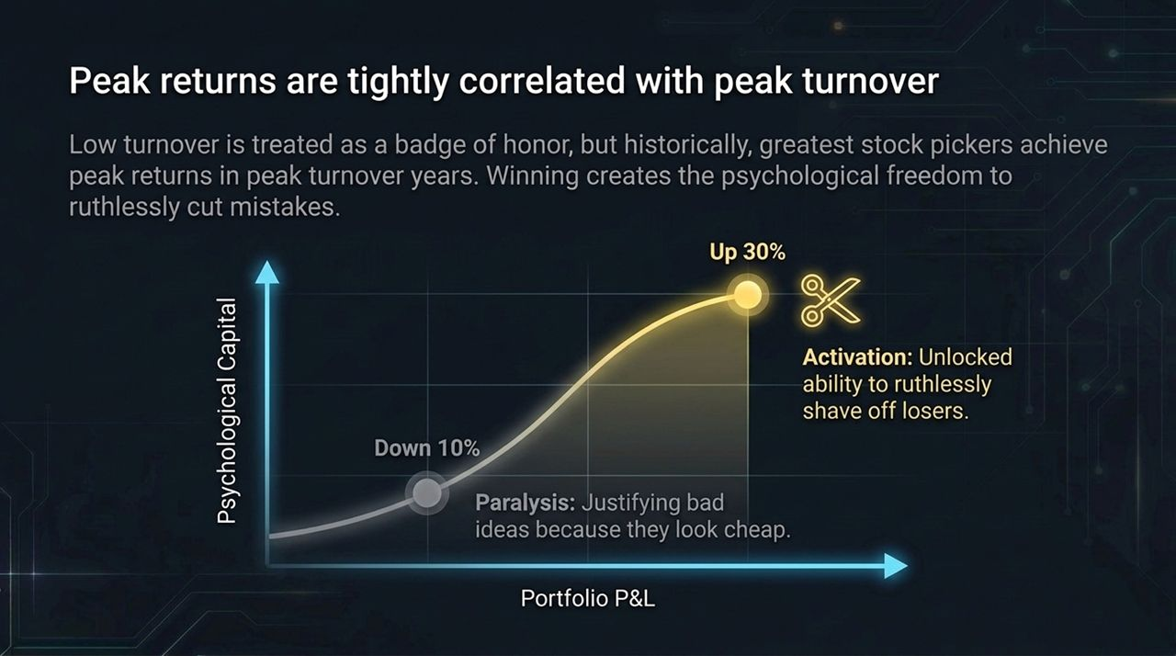
Notes:
Low portfolio turnover is often touted as a badge of honor, but historically, top stock pickers achieved peak returns during years with higher turnover.
There is a direct link between performance and emotional state: when portfolio gains are strong, investors gain the psychological freedom to cut losing positions quickly.
Conversely, during down periods, investors risk falling into analysis paralysis—holding onto underperforming positions under the guise that they are "cheap". Active turnover allows continuous recycling of capital into highest-conviction holdings.

Slide 13
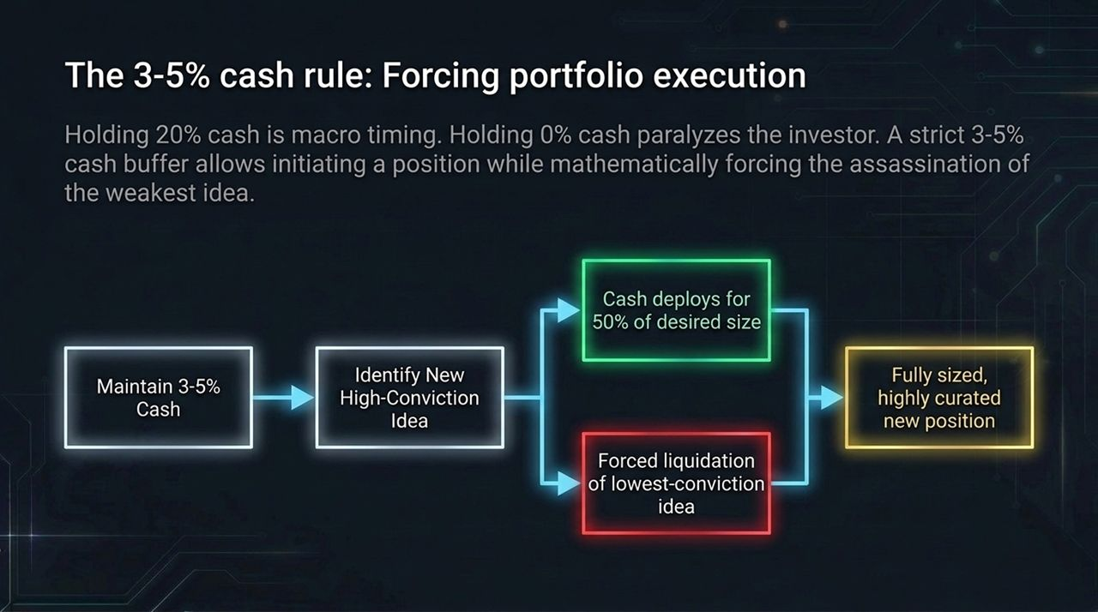
Notes:
Maintaining a 20%+ cash allocation often amounts to market timing, while holding 0% cash limits flexibility.
Adopting a strict 3–5% cash buffer strikes an effective balance:
It provides immediate liquidity to initiate 50% of a target position size when a compelling idea emerges.
To expand that new position to full size, you are forced to trim or exit your lowest-conviction holding.
This disciplined structure maintains portfolio quality through continuous competition for capital.

Slide 14
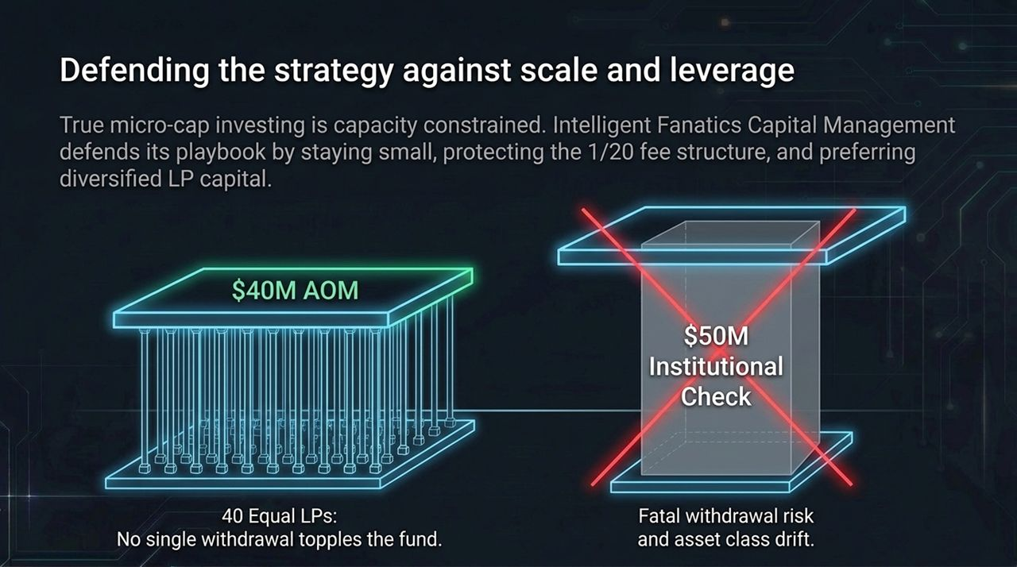
Notes:
Micro-cap strategies face natural capacity limits. Managing excessive capital compromises performance by forcing trades into larger, less efficient markets.
When running capital externally (e.g., Intelligent Fanatics Capital Management), fund stability is protected by maintaining a diversified LP base—such as 40 individual investors rather than relying on a few massive institutional checks.
A single institutional redemption can force disorderly liquidation of illiquid positions, whereas a diversified investor base ensures long-term operational resilience.

Slide 15
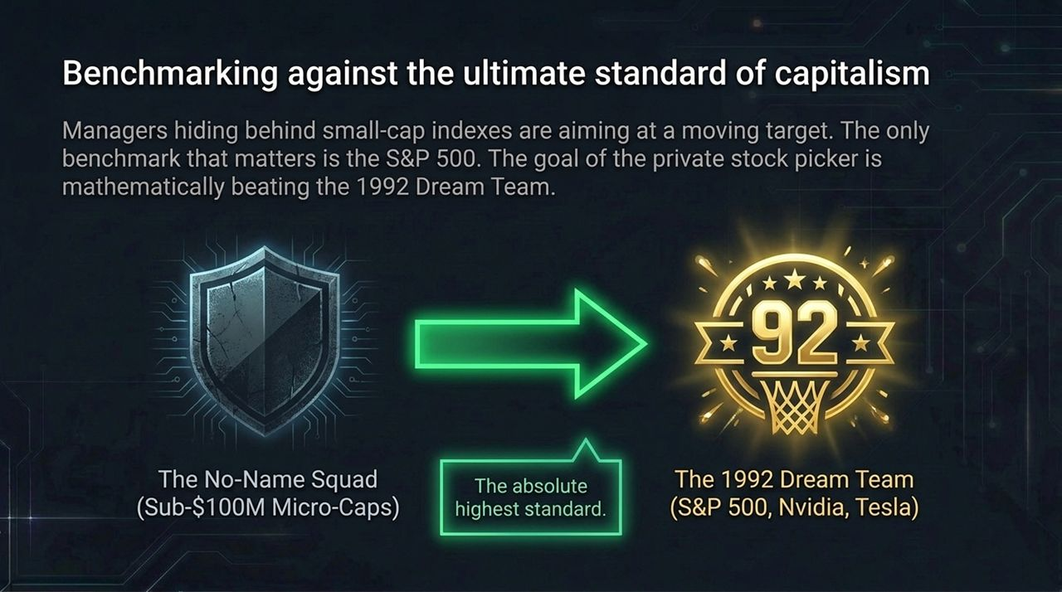
Notes:
Benchmarking against weak or declining small-cap indexes (like the TSX Venture or specialized sub-indexes) offers a false sense of performance.
The only meaningful hurdle for stock pickers is the S&P 500.
Think of the S&P 500 as the "1992 Dream Team" of capitalism—stacked with dominant market leaders. The goal of a micro-cap stock picker is to assemble a portfolio of "no-name" small companies capable of outperforming that elite market standard over time.

Slide 16
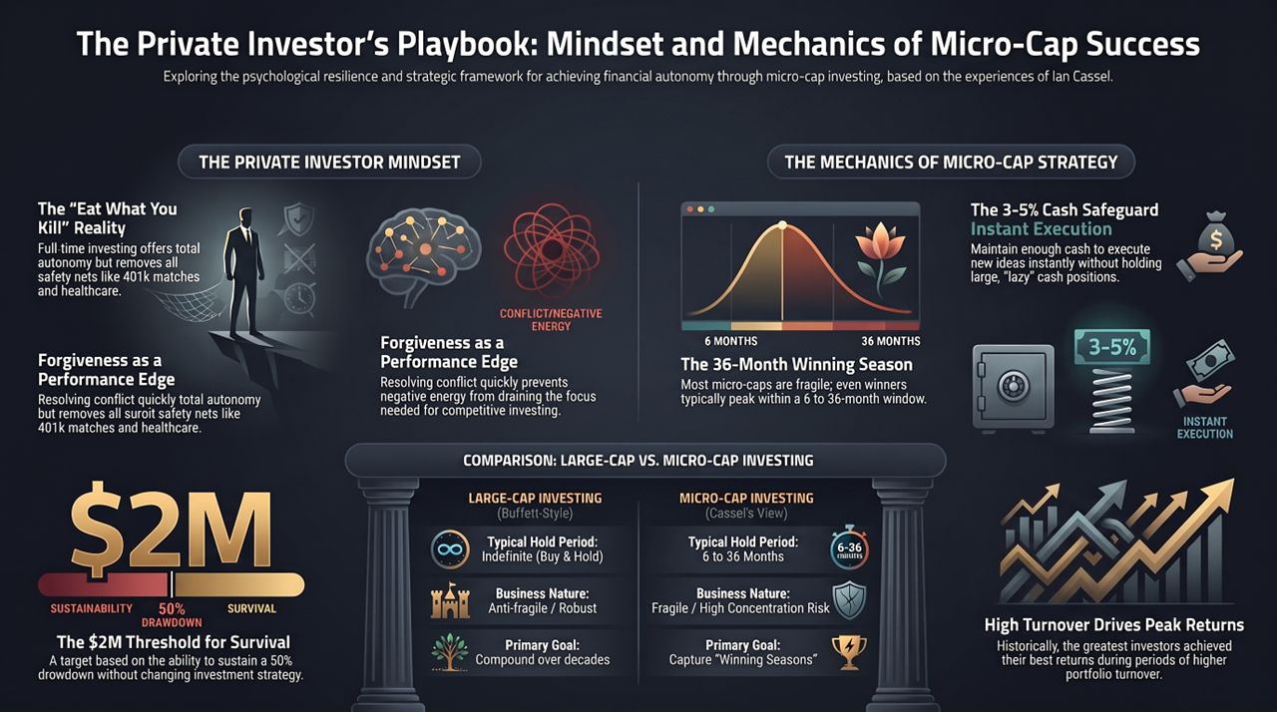
Notes:
To conclude, achieving sustainable success as an independent micro-cap stock picker requires aligning mindset with structural execution:
Mindset: Embrace the accountability of "eat what you kill," maintain financial buffers to endure 50% drawdowns, and resolve emotional friction quickly to keep mental bandwidth focused on execution.
Mechanics: Treat micro-caps as fragile businesses with 6-to-36-month performance windows. Utilize a 3–5% cash balance to stay flexible, rotate out of underperforming ideas, and benchmark continuously against the S&P 500.

